Slide 1

COVID-19 VACCINE CENTERS
Prepared by:
Yazeed Musallam
A faster way to herd immunity.

Slide 2
01.
Introduction

Slide 3
Back story of the project
40% percent of new yorkers uses the subway daily!
Placing the vaccination centers near to subway stations is great idea!
People can get can get vaccinated while going to work/home!
New York City Department of Health seeked to NYC Data Science company to answer:
Where is the most effective stations to place the vaccination centers near by?

Slide 4
Scope of the project
Sample size:
- Four months worth of data (3M rows); reason:
NYC started to distribute vaccine for all ages before 4 months.
Datasets used:
- MTA turnstile dataset.
- MTA subway stations zip code dataset.
- NYC-health COVID-19 vaccine dataset.

Slide 5
02.
Exploratory Data Analysis

Slide 6
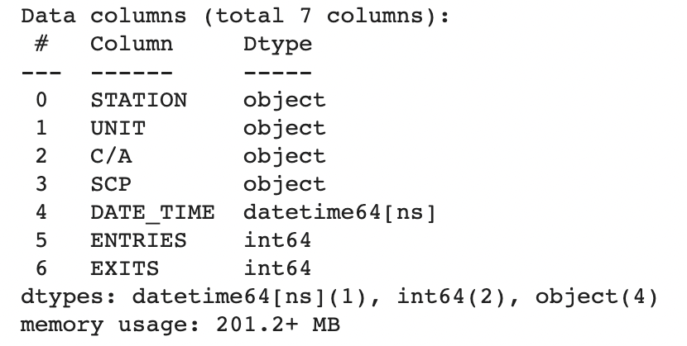
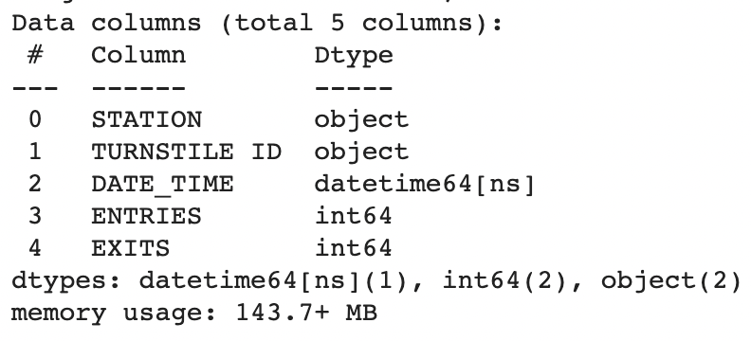
Working with the dataset
Grouping each turnstile
Assumation:
SCP
C/A
UNIT
STA
Total number of turnstiles: 5032

Slide 7
Working with the dataset
MISSING VALUES
NO MISSING VALUES ARE FOUND
DUPLICATES
THERE ARE DUPLICATES IN DESC COLUMN
DUPLICATE ARE REMOVED

Slide 8
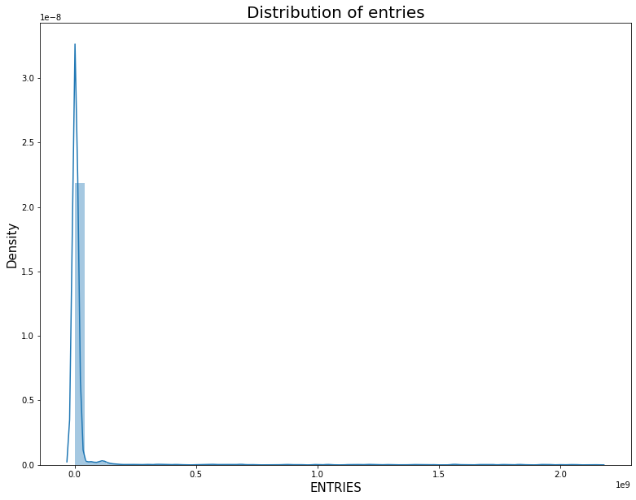
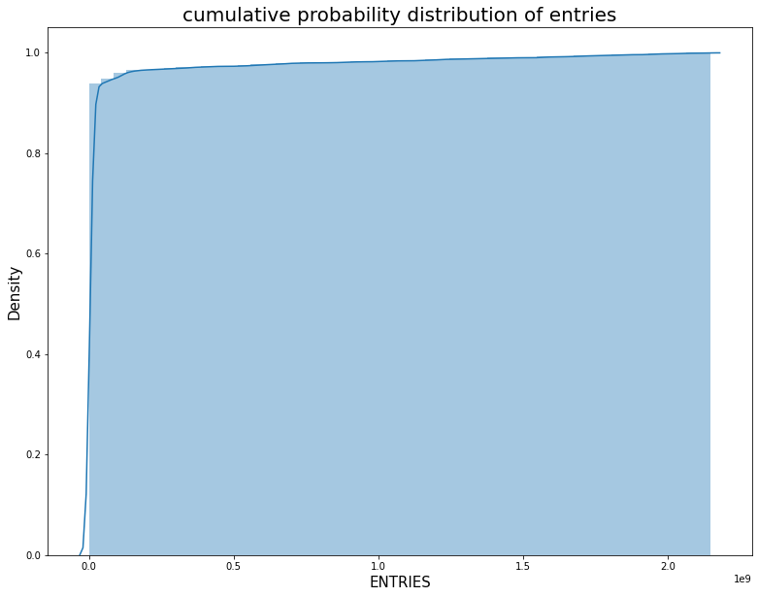
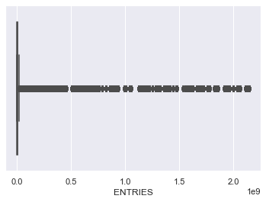
Visualizing the data
Dataset suffers from severely outliers!

Slide 9
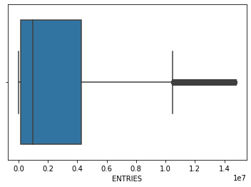
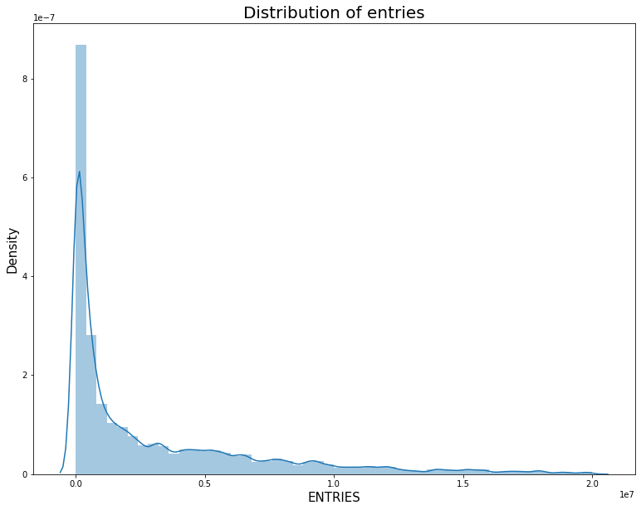
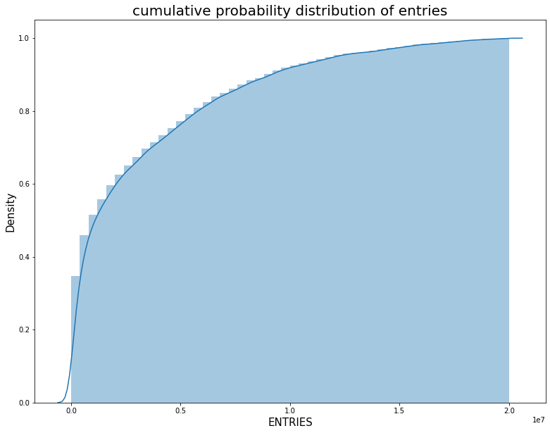
Working with outliers
Outliers threshold?
Outliers after 15M entries for each turnstile (Using IQR)
Empirically 20M was chosen to avoid loss of important information.
Similar process was done to exits

Slide 10
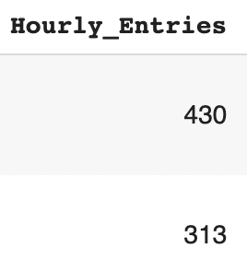
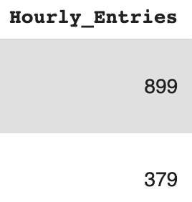
1.1) Working with data - Hourly entries/exits
Challenges and solution
Observation:
If turnstile counting are reversed.
If counter increasing to more than limit of 900 per turnstile for each four hours.
If turnstile is suddenly overshooting in unusual behavior.
Same time different day
DAY A
DAY B

Slide 11
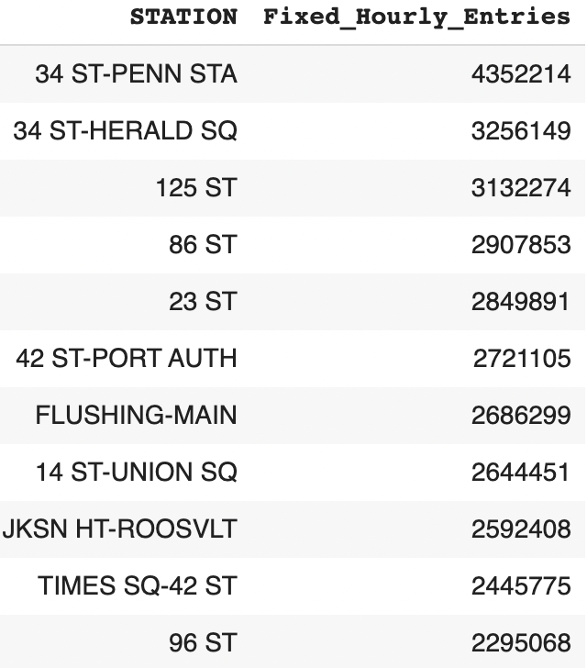
1.2) Working with data - Hourly entries/exits
Challenges and solution
Solution to overshooting ?
1.1) Get the median of same day at same time in different weeks.
2.2) Removing outliers for each station.

Slide 12
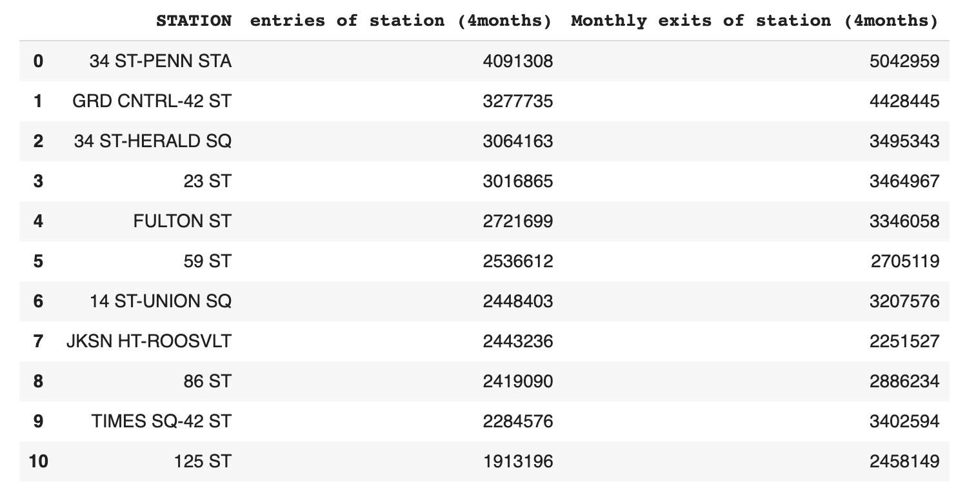
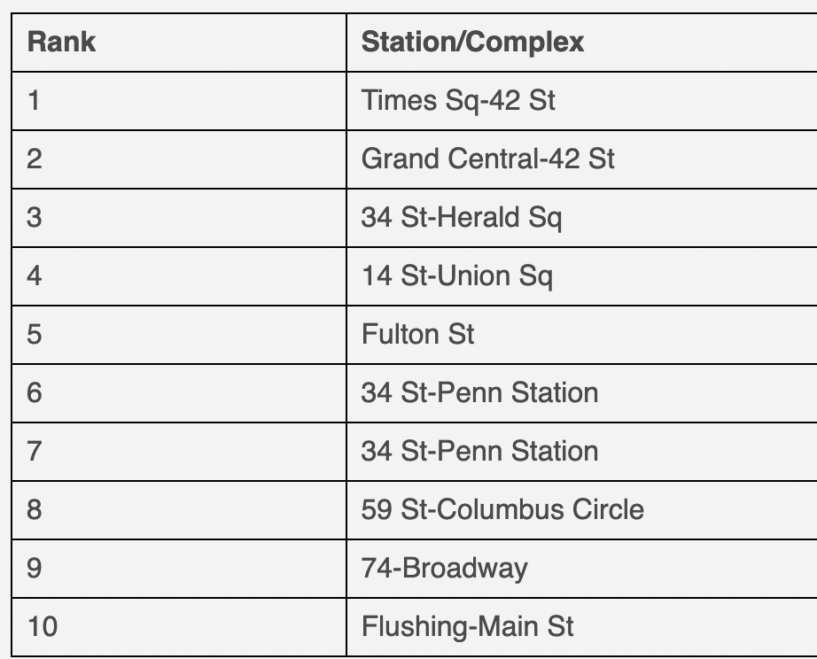
1.2) Working with data - Hourly entries/exits
Results by removing only outliers for the whole dataset.
Source: MTA website - 2020

Slide 13
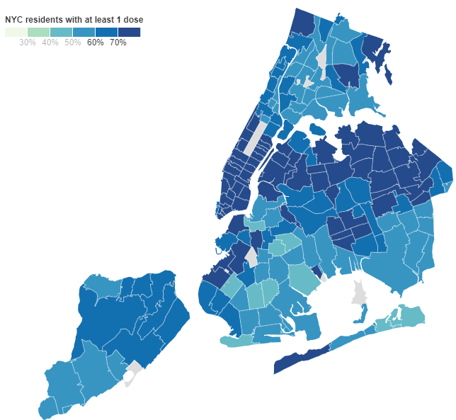
NYC-health vaccine dataset
Observation from data:
The total percentage of fully vaccinated: 61%
Total station in areas that has more than 70% vaccinated: 52

Slide 14
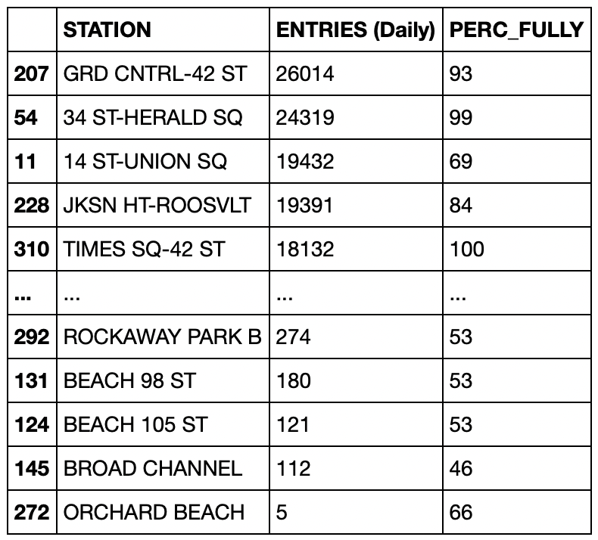
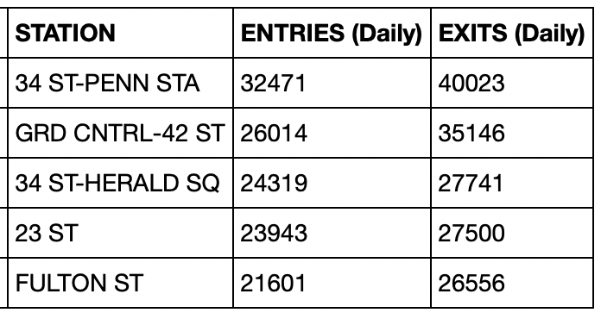
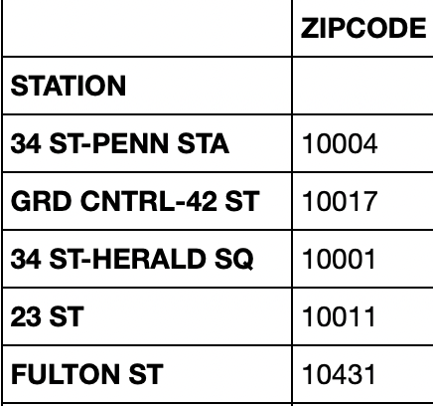
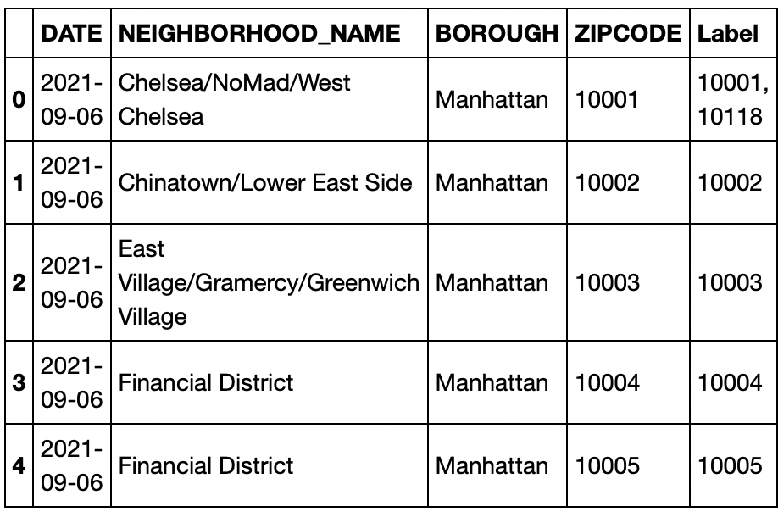
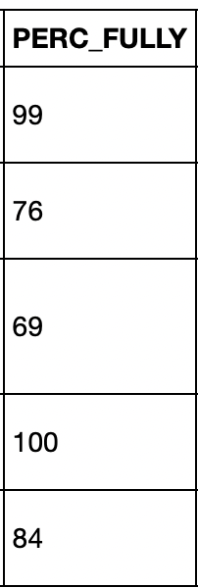
Mapping MTA dataset to NYC COVID dataset
MTA DATA SET
MTA ZIP CODES DATA SET
NYC COVID-19 vaccine dataset

Slide 15
02.
Insights

Slide 16
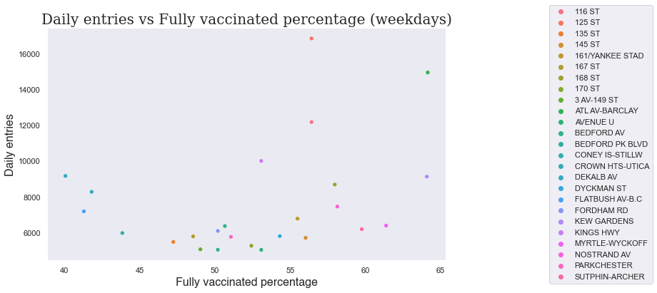
Daily entries vs. vaccine percent by station

Slide 17
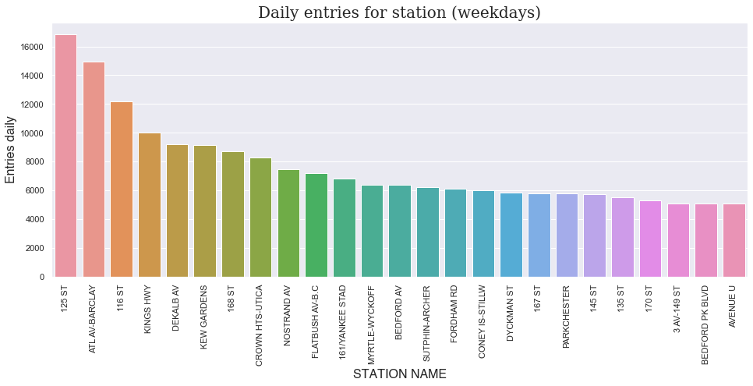
Daily entries for stations - weekdays

Slide 18
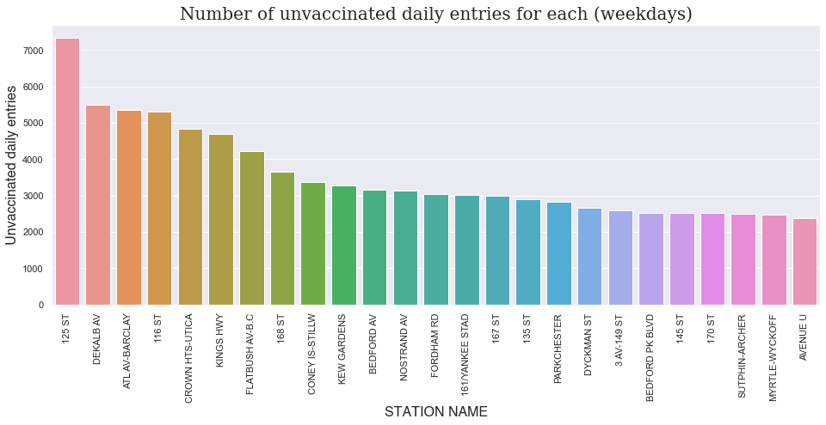
Number of unvaccinated for each stations - weekdays

Slide 19
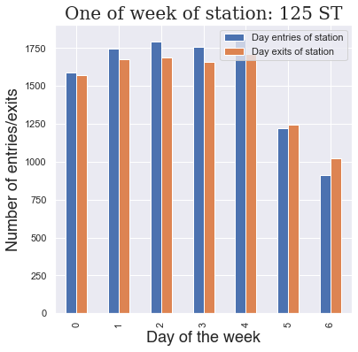
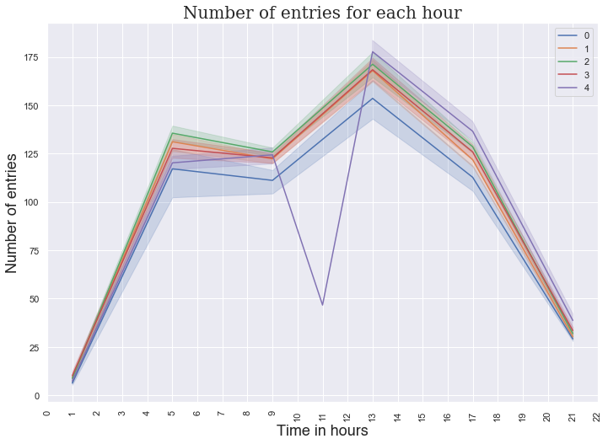
Analysis of entries/exits

Slide 20
THANKS!
Future works:
Automated weekly reports of best vaccine centers.
Use dashboards i.e. using Tableau.

